Slide 1

COVID-19 CLINICAL TRIAL PROJECT 1
GROUP MEMBERS:
Mohamed Aziz, Pamela Schau
Mario Shields, Qian Sun, Abel Rodriguez

Slide 2
FOCUS: COVID-19 CLINICAL TRIALS SOURCE OF DATA: CLINICALTRIALS.GOV (A RESOURCE PROVIDED BY THE U.S. NATIONAL LIBRARY OF MEDICINE) QUESTIONS/IDEAS: *THE AVERAGE LENGTH OF TRIALS *STUDIES BASED ON THE 4 PHASES *ENROLLMENT & TRIALS BASED ON GEOGRAPHICS *THE TENDIENCES OF ENROLLED PARTICIPANTS THAT SHOW RESULTS VS. NO RESULTS *THE COUNT OF SUCCESSFUL CLINICAL TRIALS BASED ON DRUGS & P-VALUES VISUALIZATIONS: BAR GRAPH, PIE CHART, BOX PLOT, SCATTER PLOT, MAPS

Slide 3
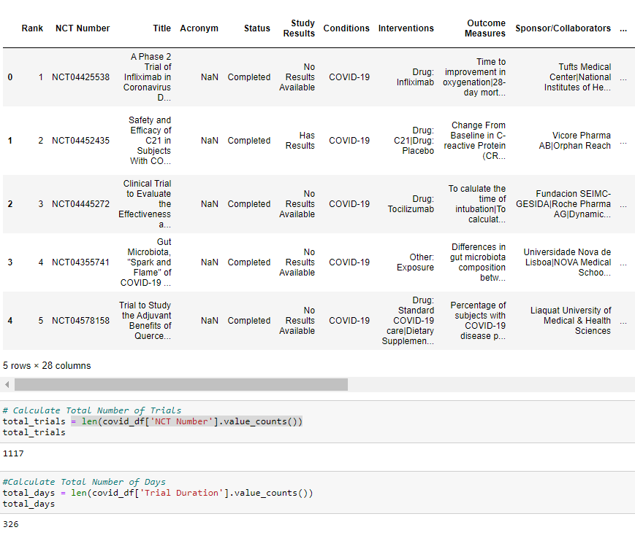
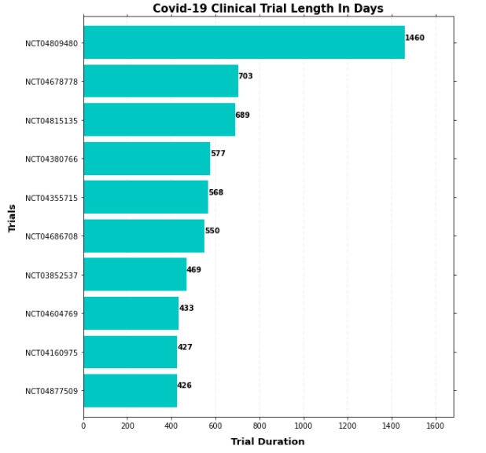
TRIAL LENGTH TOP 10 LONGEST TRIALS

Slide 4
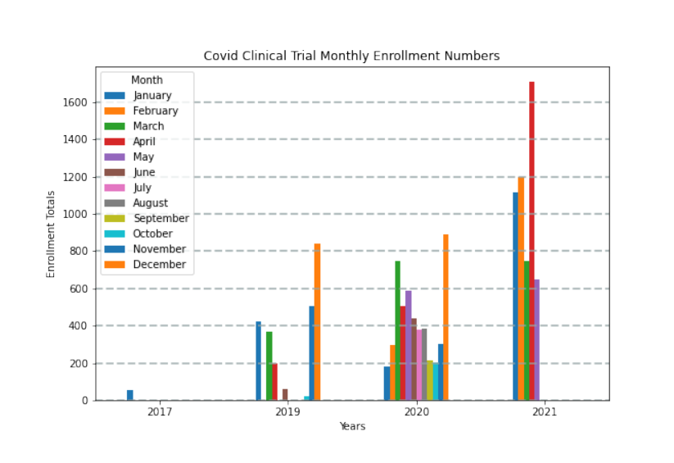
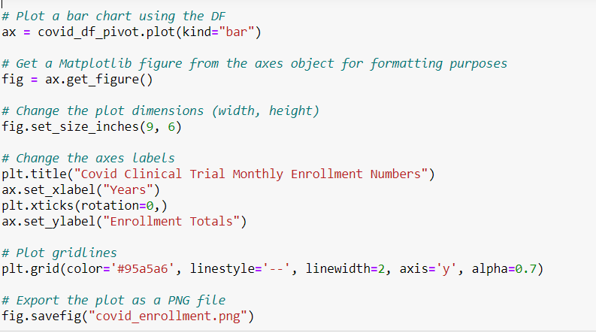
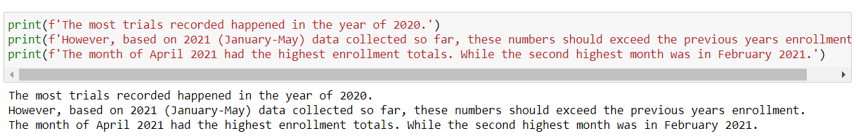
TOTAL ENROLLMENT NUMBERS

Slide 5
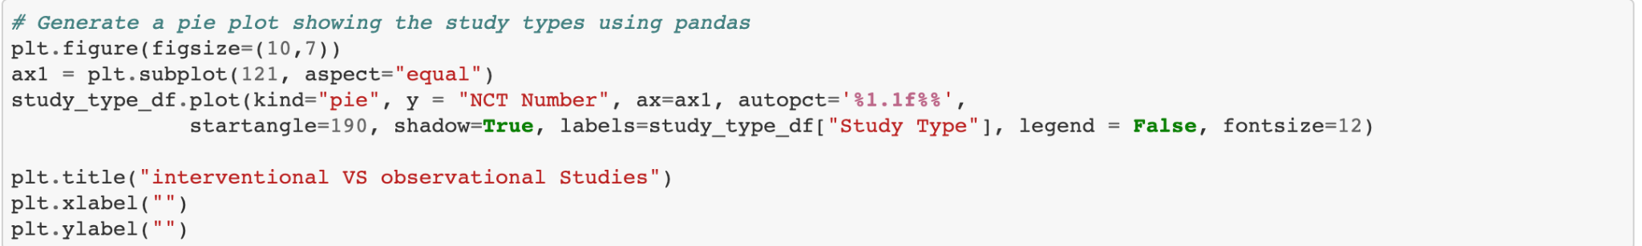
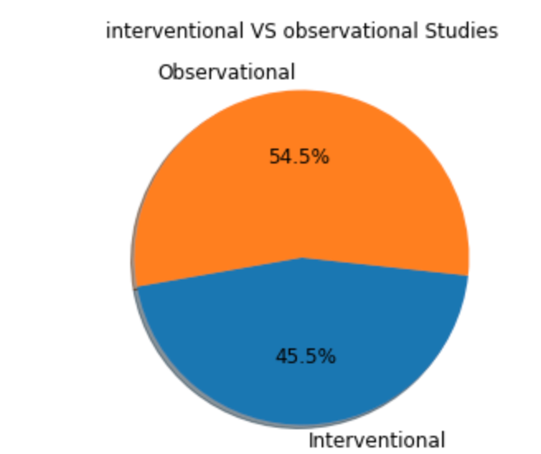
Observational Trial VS Interventional Trials

Slide 6
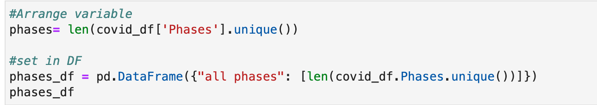
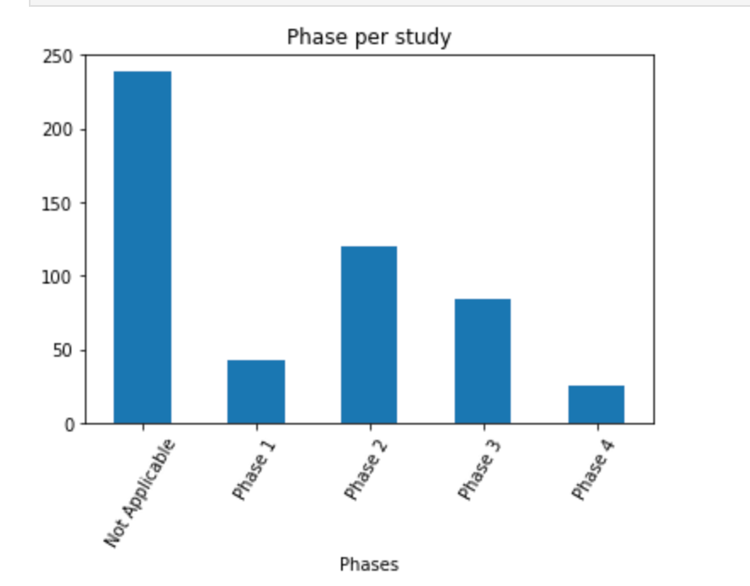
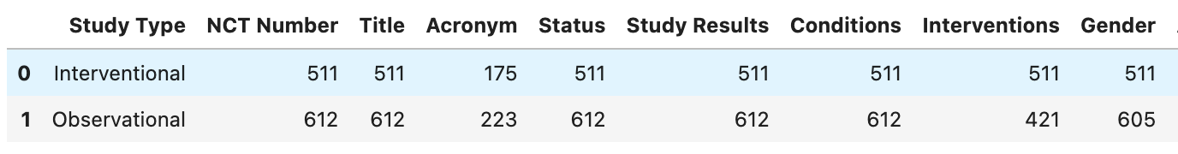
DATA FINDINGS: Data Findings: Interventional Clinical Trials Analysis required exclusion of observational clinical trials data

Slide 7
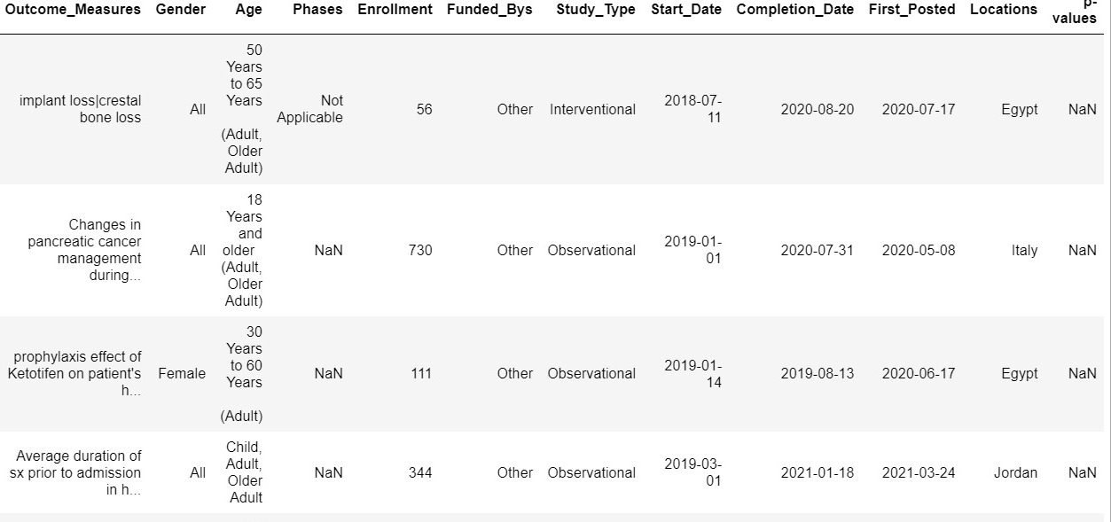
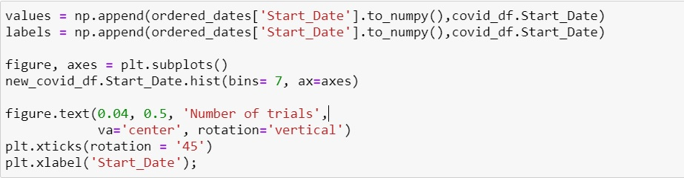
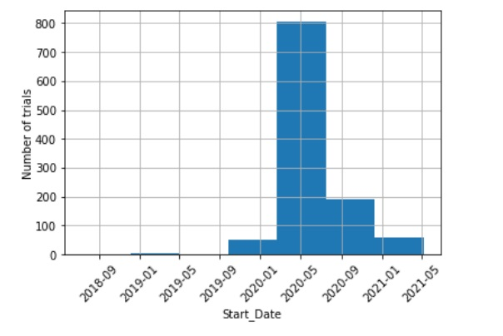
NUMBER OF TRIALS THROUGHOUT PREVIOUS MONTHS
Plot number of trials distributed by date
Most trials occurred in March 2020 with over 800 trials; about 4 times as much compared to other previous months.

Slide 8
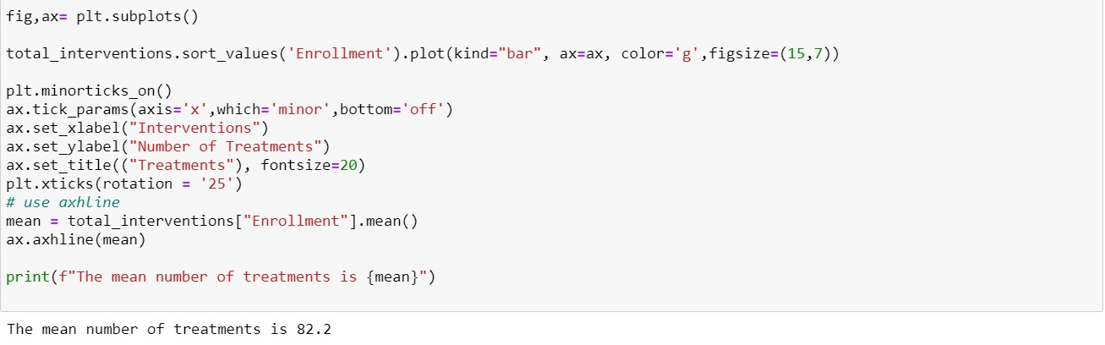
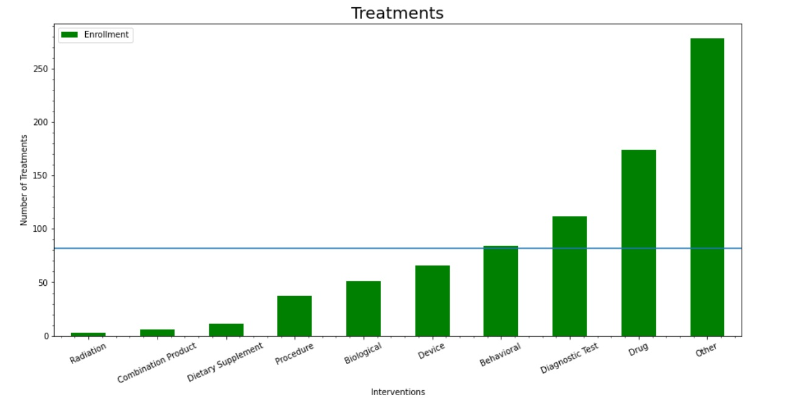
ENROLLMENT STATISTICS BY INTERVENTIONS
1. The Average Line shows the number of treatments that fall below, near, and over the average number (≈ 82) of treatments
2. Behavioral, Diagnostic Test, Drug, and Other type of treatments are overrepresented in this analysis

Slide 9
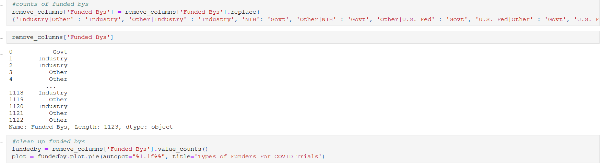
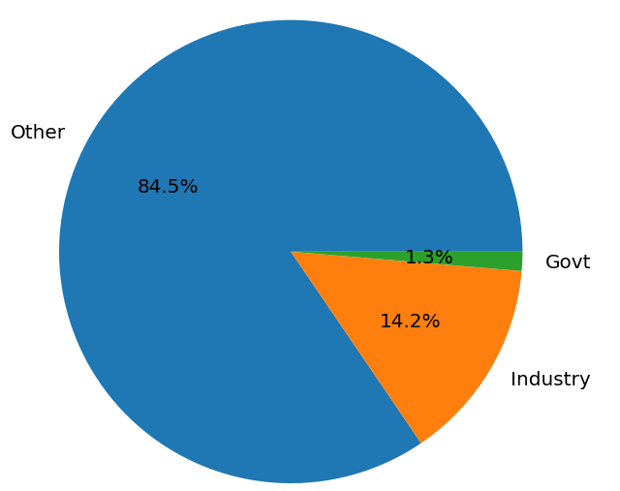
FUNDING OF TRIAL: MOST FUNDERS WERE NON-GOVERNMENT/ INDUSTRY
Types of funders for COVID Trials
Other category was mostly academic medical centers

Slide 10
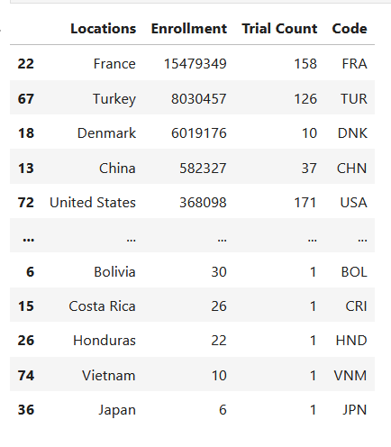
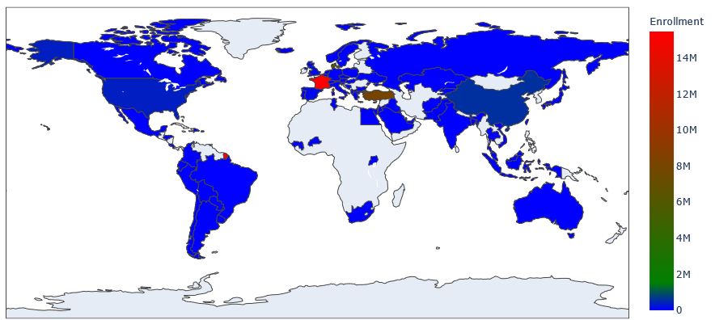
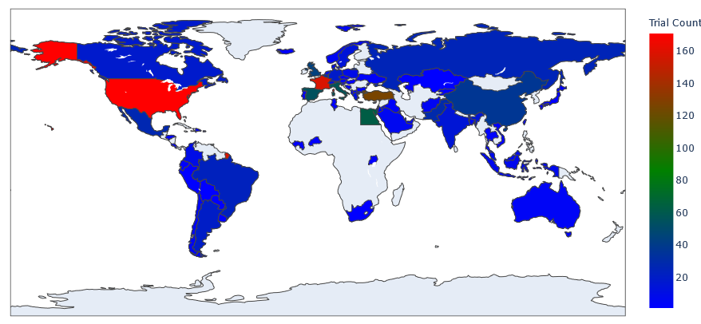
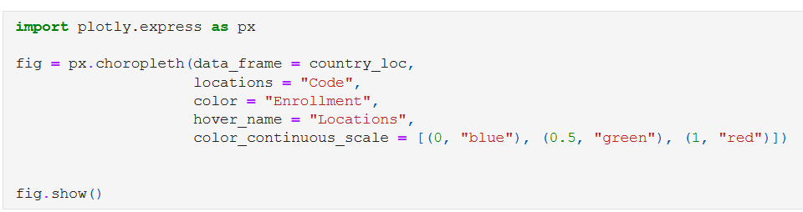
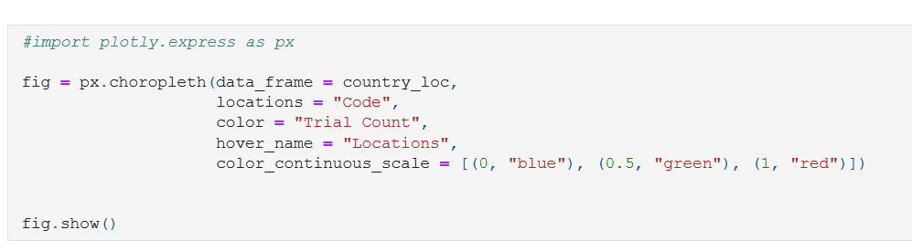
TRIAL LOCATIONS: MOST TRIALS WERE CONDUCTED IN USA AND FRANCE. FRANCE HAD THE HIGHEST ENROLLMENT.

Slide 11
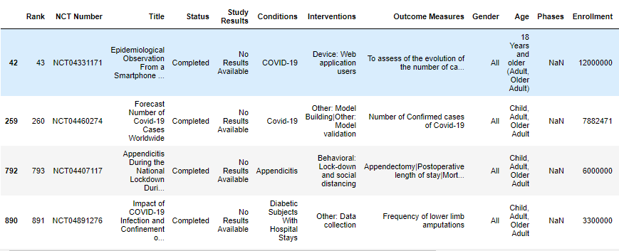
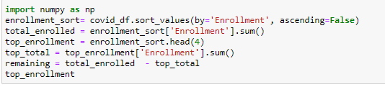
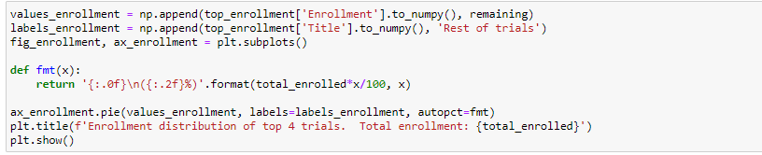
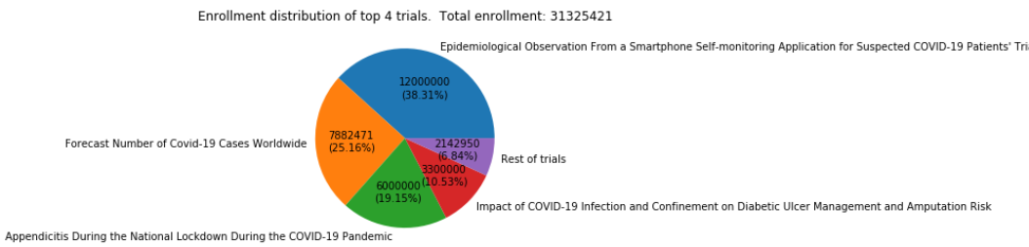
ENROLLMENT DISTRIBUTION AND TOP ENROLLMENT VS REST
Plot enrollment trials distribution
The top 4 trials by enrollment comprise over 93% of total enrollment

Slide 12
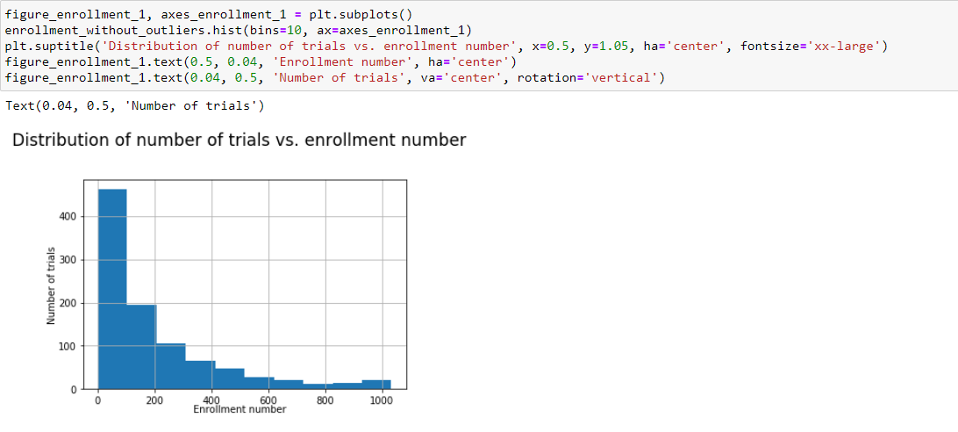
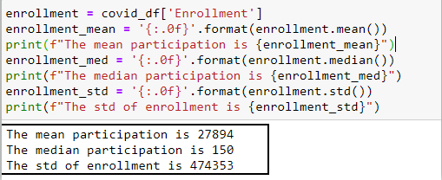
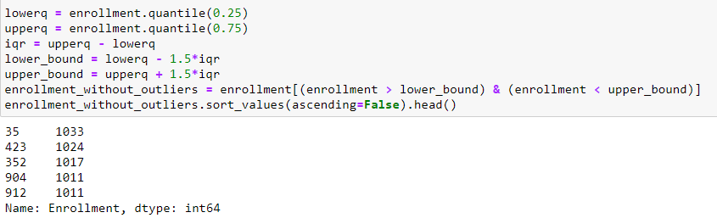
ENROLLMENT STATISTICS: DISTRIBUTION
Enrollment histogram without outliers
1. Total enrollment (195894) without outliers is much less than any one outlier
2. Median shows the huge number of low enrollment
3. he higher the enrollment number, the fewer trials there are with that number

Slide 13
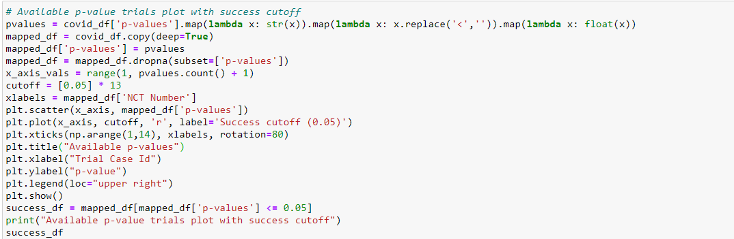
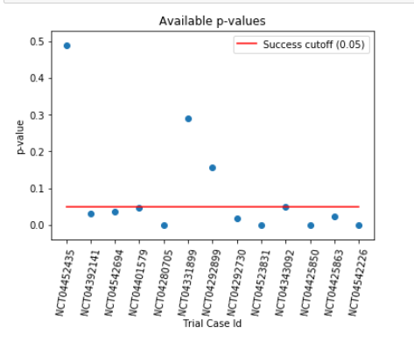
THE MOST SUCCESSFUL CLINICAL TRIALS BASED ON P-VALUE
Based on p-value cutoff of 0.05 there are 10 successful trials out of 13 available p-values

Slide 14
Conclusions
This project analyzed clinical trials related to COVID-19.
We examined:
-when and where these trials were conducted,
-the number trials and participants in the trials,
-types of interventions,
-as well as the relative success of the trials.
We found that:
The average length of trials was 136 days
Most trials were conducted around May/June of 2020
There was equal split between interventional and observational studies, with the interventional studies mostly in Phase 2 and consisting of drugs.
Most trials were conducted in USA and France with the most enrollment numbers in France.
Based in reported p-values, we identified 10 successful interventional trials
Other Considerations:

